Slide 1

Rolling out services
Wesley Hotel, London, May 12th 2016
Jonathan Rans
Digital Curation Centre
This work is licensed under the Creative Commons Attribution 2.5 UK: Scotland License.

Slide 2
Some lessons from the IE programme
Some institutions still have fragile RDM programmes
  Reliant on one or two individuals
  No institutional memory
In some places services are beginning to be embedded but aren’t joined up.

Slide 3


The size of institutions has an impact
Large, hierarchical institutions
  Move slowly
  Require a lot of advocacy
  Have more resource
  Economies of scale
Smaller institutions
  More agile
  Simpler communication
  More focussed vision
  Less resource

Slide 4
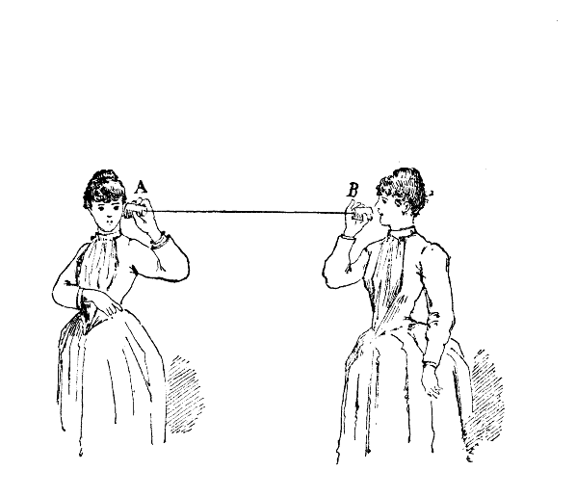
Channels and communication
Technical considerations
  What systems need to integrate
  How can choice of system promote engagement and information flow
Cultural considerations
  Who needs to communicate
  What structures/workflows need to be in place
Notes:
When we are talking about channels it helps to think both about what stakeholders or systems need to be connected and how systems can be designed to promote engagement with these channels.
Engaging researchers with new services
> Eg Repositories which often take time to populate
Communication between departments
> Eg the disconnect between library-based RDM services and RO DMP advice

Slide 5
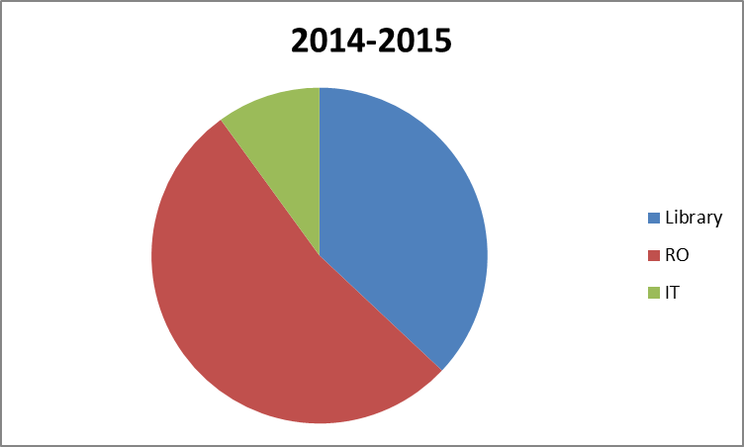
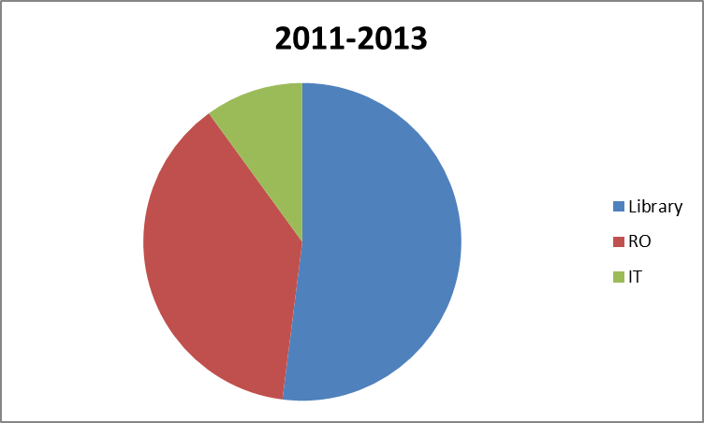
UK policy has had an impact
RDM project lead

Slide 6

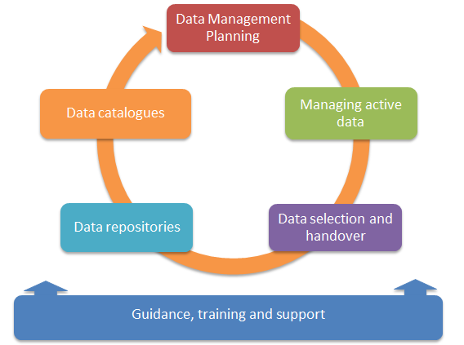

Slide 7

Data management planning
Data management planning ideally brings all stakeholders together.
Key challenges:
  Distilling a range of policy requirements
  Connecting researchers to expert guidance
  Making use of the information researchers provide
https://dmponline.dcc.ac.uk/
Notes:
One of the challenges for third-party service providers potentially is to tier their offerings to suit the aims and resources of their customers. Take DMPonline as an example – it can be used out of the box and offers a quality level of end-user functionality. With additional resource from the participating institution utility can be enhanced through provision of local guidance and researcher engagement can be improved through development of an institutional interface.
Consider the end-user, how they will engage with a service and lowering the barriers to adoption – institutional interfaces

Slide 8
Active data management
Key challenges
Understanding what you need
Integrating services from external providers
Scalability
Opportunities to connect to other systems
Notes:
In the UK various examples of integrations – eg Loughborough etc.

Slide 9
Data selection and handover
Key challenges
Enabling researchers to identify data of value
Defining what should be kept
Helping researchers to identify data with access restrictions
  Providing advice/infrastructure on what to do with this data ex – data vault

Slide 10
Data repositories
Key challenges
Developing a repository ingest policy
  Define limits on size, formats and content
  Johns Hopkins
Link datasets to associated publications and outputs
  UAL repository
Offer guidance on data citation
  http://www.dcc.ac.uk/resources/how-guides/cite-datasets
Notes:
Also DCC how to cite datasets

Slide 11
Data catalogues
Key challenges
Defining a set of metadata to publish
  See: DataCite, OpenAIRE, RDDS, RADAR
Reducing duplication of effort by harvesting information from other systems
Linking to other outputs

Slide 12
Training and guidance
Key challenges
Providing a baseline service
  Edinburgh’s MANTRA materials
  University of Bath guidance pages
Identifying which local information must be included
Identifying how much resource is required
  For maintenance?
  For expansion
Notes:
One of the key points connecting researchers with services are institutional RDM guidance web-pages.

Slide 13

Final thoughts
There are challenges but also opportunities in implementation for improving connection.
What is proportional and feasible?

Slide 14
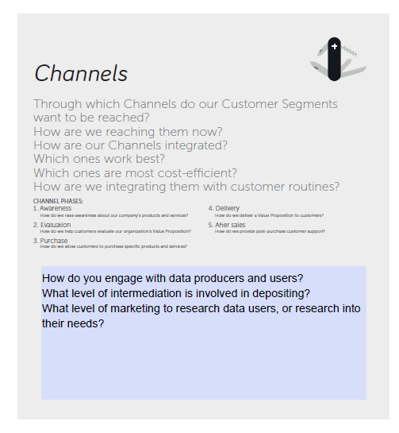
Exercise: Identifying service channels
Reconvene in your groups and chose two or three of your key activities, discuss for each:
Which channels work best to deliver value to your customers
Which channels do your customers use to connect with you as service providers
Which channels does the service use to promote awareness

